Slide 1
Data Programming BDAT 1004 Final Project
Group – 2
Akshat Patel(200501942)
Grant Friend(200506581)
Sweta Patel(200468627)
Anjaliben Patel(200510975)
Ansar Atiq(200520055)

Slide 2
Agenda
Introduction
Project Summary
Dataset Description
Dataset
Business Questions
Data Visualization
Analysis Result
Conclusion

Slide 3


Slide 4
Introduction
Netflix is a popular streaming service that offers a vast catalog of movies, TV shows, and original content. It's available on smart TVs, through streaming devices, and even on your smartphone and tablet using the official app for iOS or Android.
According to Netflix, over 75% of viewer activity is based off personalised recommendations. Netflix collects several data points to create a detailed profile on its subscribers. The profile is far more detailed than the person created through conventional marketing.
Netflix’s ability to collect and use the data is the reason behind their success. According to Netflix, they earn over a billion in customer retention because the recommendation system accounts for over 80% of the content streamed on the platform. Netflix also uses its big data and analytics tools to decide if they want to greenlight original content.
Notes:
Reference - https://seleritysas.com/blog/2019/04/05/how-netflix-used-big-data-and-analytics-to-generate-billions/

Slide 5
Project Summary
As the largest streaming service in the world, Netflix is absolutely dominating the streaming video market. The released content is based on viewers’ needs which in turn generates revenue for the organization
XYZ Company is a company that looks at the listings of Netflix content based on its types like movies and tv shows. It analyses based on the release year and other parameters. This is very important. So our job is to develop a web application for that.

Slide 6
Dataset Description
Netflix is one of the most popular media and video streaming platforms. They have over 8000 movies or tv shows available on their platform, as of mid-2021, they have over 200M Subscribers globally. This tabular dataset consists of listings of all the movies and tv shows available on Netflix, along with details such as - cast, directors, ratings, release year, duration, etc
Reference : https://www.kaggle.com/datasets/shivamb/netflix-shows
Total number of rows : 8808
Total number of columns : 12

Slide 7
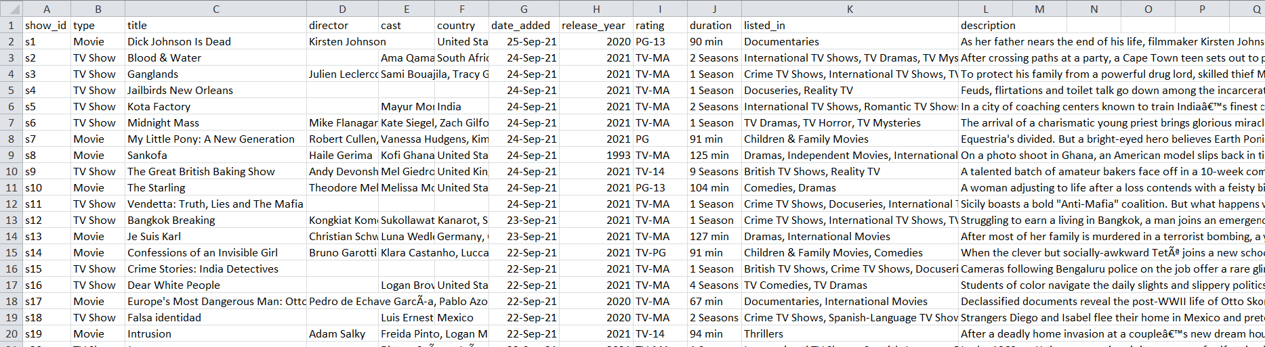
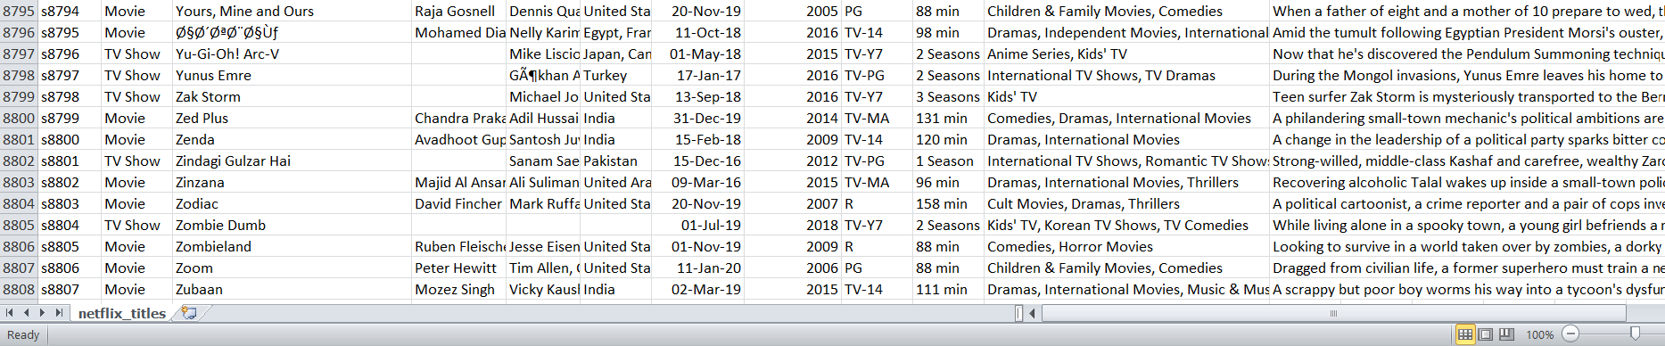
Dataset

Slide 8
Business Question
Which country has highest average value for netflix online platform?
Which type movies or show are streaming more on netflix?

Slide 9





Tools
Data Collected – Kaggle.com
Data Storage – MongoDB
Chromedriver Selenium
Flask
Google Charts

Slide 10
Data Visualization

Slide 11
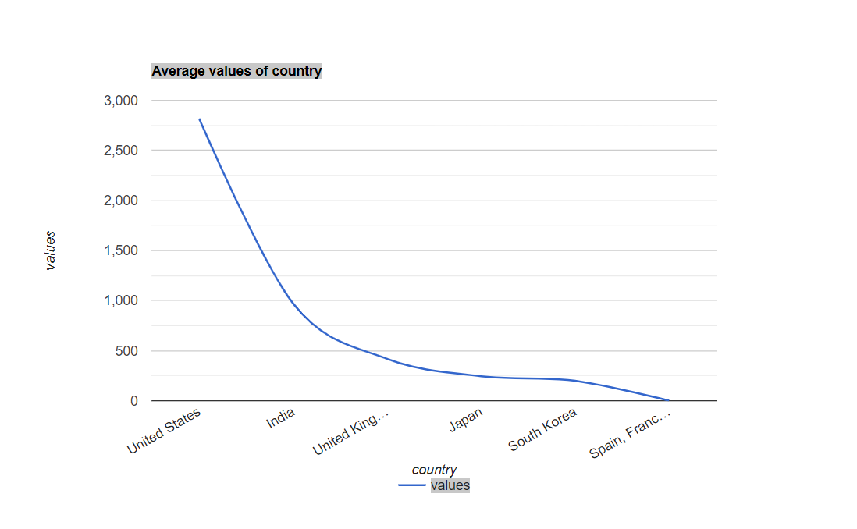

Slide 12
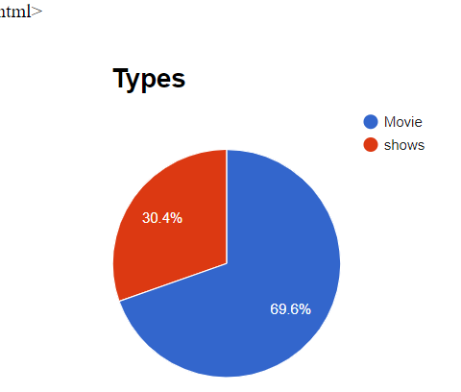

Slide 13
Analysis Result
From the pie chart, it clearly shows that Movies show types(6131) are popular in demand
From the line chart, it shows that United states has highest average value for this netflix streaming platform

Slide 14
Conclusion
As per the analysis results, majority of the show types are Movies with 2018 recording the highest number of release
Overall, the analysis gives an overview of the movies and TV shows which streaming on this platform
Also, netflix trending all over the social media market for best streaming platform and growing steadily .

Slide 15


